Slide 1
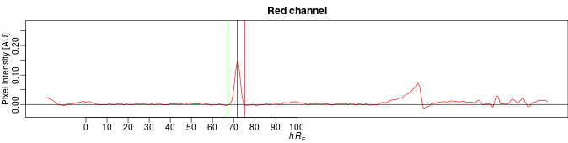

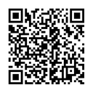
quanTLC manual
May 31, 2018
QuanTLC can be accessed online: 134.176.7.66/quanTLC.
The github repository with the code source is here
The peer review article is available here.

Slide 2
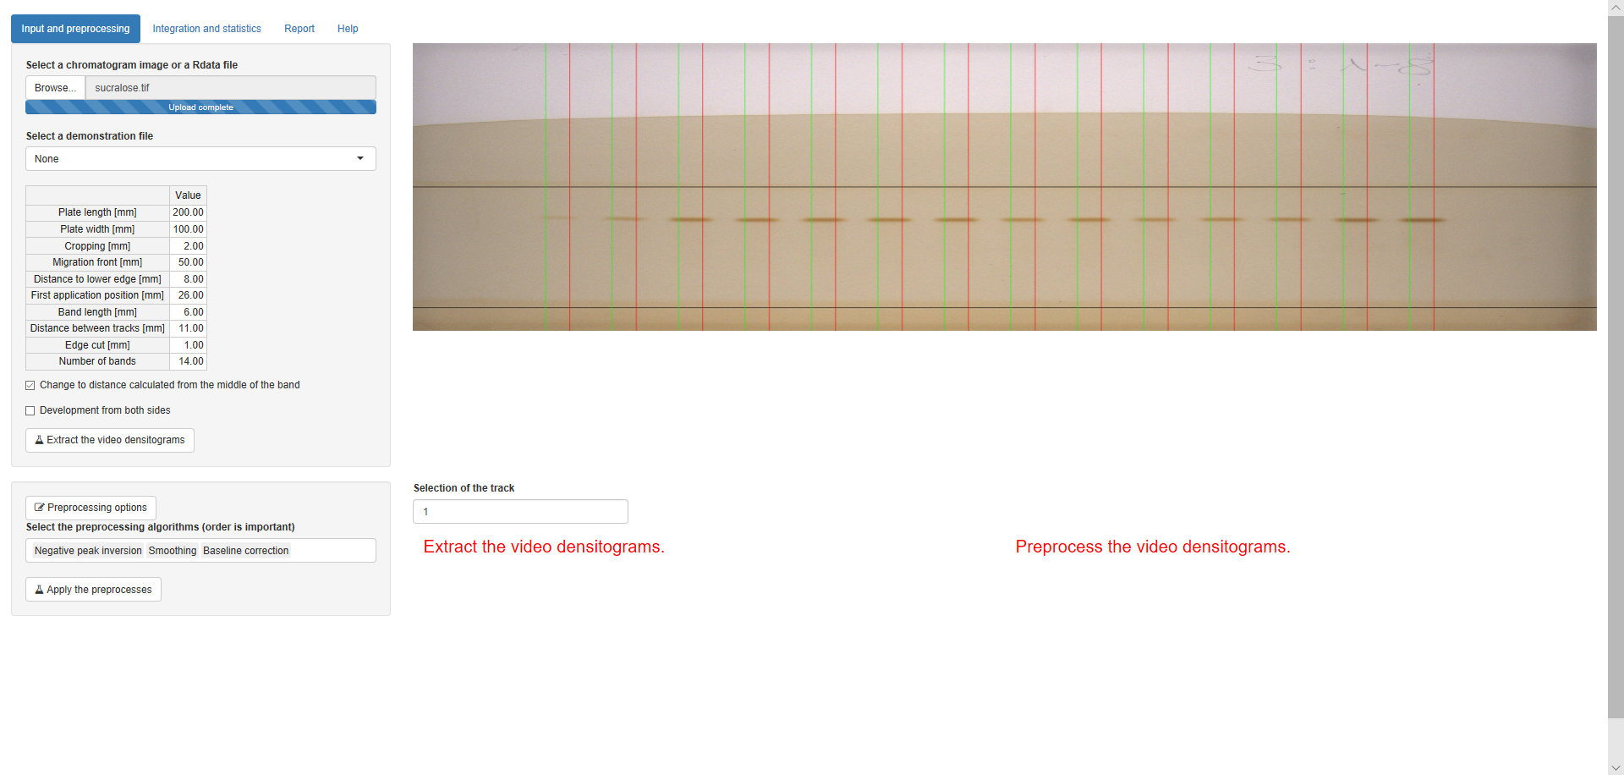
1
2
Data Input
1. Upload an image file (jpeg, png, tiff and bmp are supported). A saved *.Rdata file can also be be uploaded here for reprocessing (cf. Data output section)
2. Optionally, select a demonstration data file. The experiment shown here is available as demonstration file “sucralose”.

Slide 3
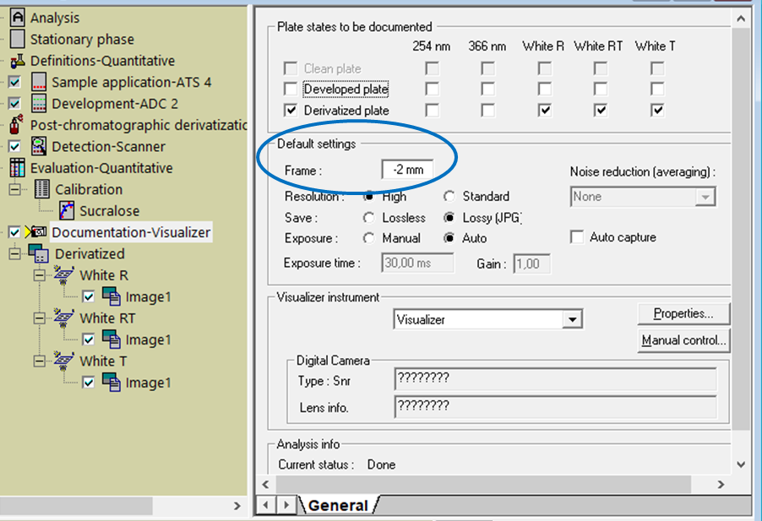
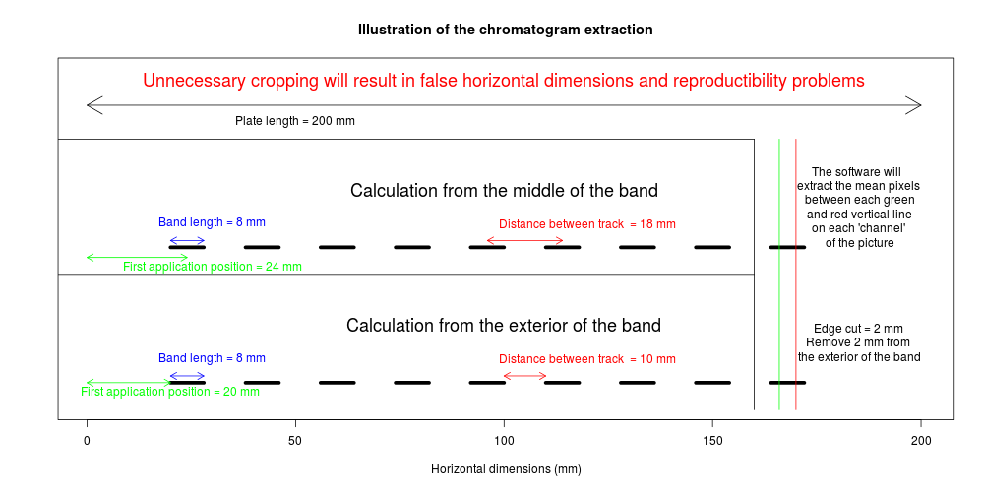
Videodensitogram extraction
1. Input the plate size, track pattern information and migration distance used during the experiment.
Cropping [mm]: refers to “Frame” in the General settings for the Visualizer in WinCATS (cutting the image).
Use “Edge cut [mm]” to only use the center of the zones for evaluation, as 4 mm for a Band length of 6 mm.
1

Slide 4
2
3
4
5
2. The chromatogram image update directly the band position, bands will be extracted between the green and red vertical lines.
3. Check for a calculation from the middle of the band, as is standard for winCATS.
4. Check here in case of double side development.
5. Finally, click on this button to extract the videodensitograms.
Note that it is possible to extract automatically the track information by clicking on the image (2). Hover the image for instructions.

Slide 5
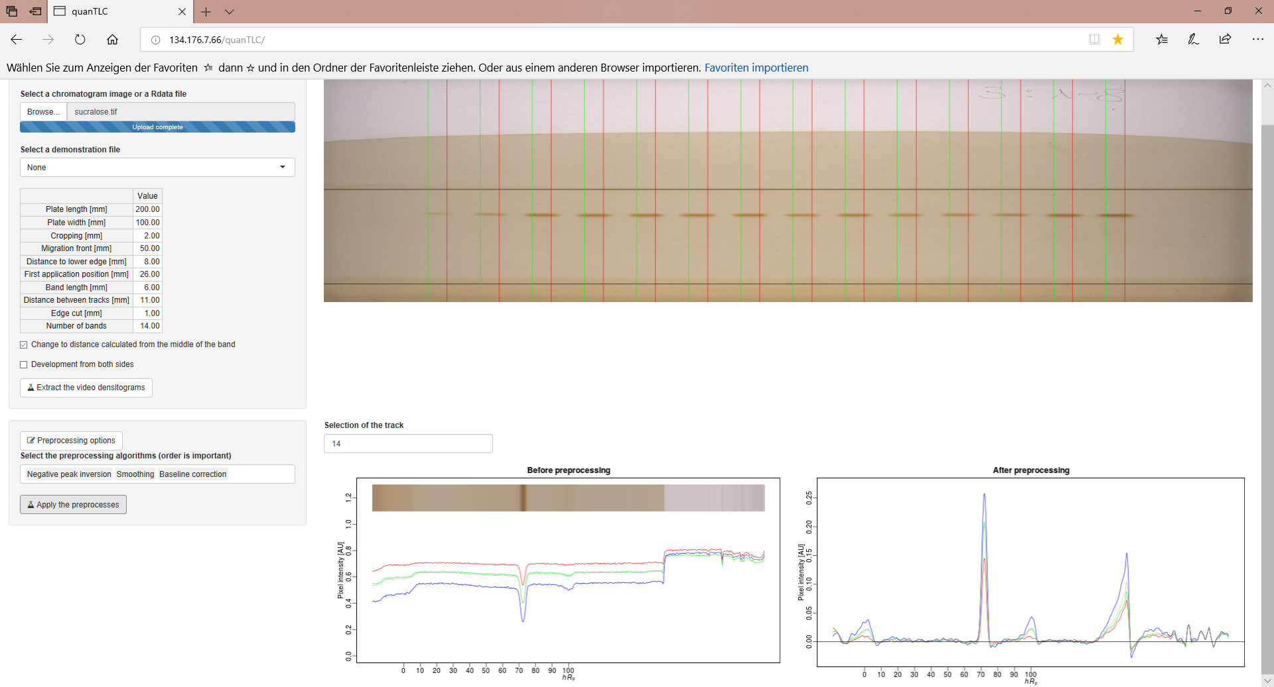
2
2
1
1
Data Preprocessing
1. The raw extracted videodensitograms are plotted.
2. Each track can be selected for preview.

Slide 6
6
2
1
3
5
4
Data Preprocessing
3. Select a set of preprocessing parameters by clicking the input line and the on the parameters (normally, smoothing then baseline correction works correctly, preceeded by peak inversion if needed).
4. Click on this button to perform the preprocessing.
5. The preprocessed videodensitograms are plotted.
6. Optionally, more choices are possible for the preprocessing (open the Options windows and try), but the default should work though.

Slide 7
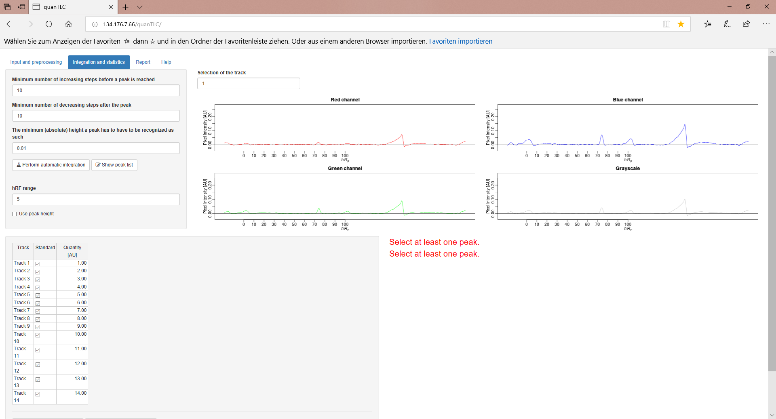
1
2
3
Peak detection
1. Select the tab “Integration and statistics”
2. The options used for peak detection and the button for peak detection. Note that this algorithm is not the best and you may need to fine tune the preprocessing if not all peak are detected.
3. Click on “Perform automatic integration”.

Slide 8

1
5
4
2
3
6
4. The detected peaks are plotted for each channel.
5. Each track can be selected for preview.
6. It is possible to look in detail by showing the peak list opening in a new window.

Slide 9

1
2
Calibration
1. Select the pixel window (tolerance for peak selection) and if you want to use peak height instead of area.
2. Input which tracks provide standards and what is the targeted value for each in units you want to use (AU), like ng/zone.

Slide 10
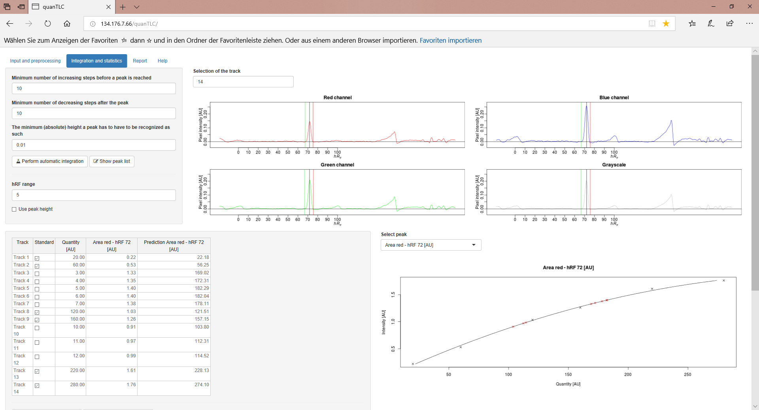
3
1
2
4
3. Click on a peak on the plot.
4. The calibration curve is plotted, multiple clicks in the other channels will lead to multiple calibration. Note that once a peak is selected, the table become read-only to avoid inconsistency.
The predicted values for each sample and standard are updated in the table (2) to be used for calculating the sample concentrations.

Slide 11
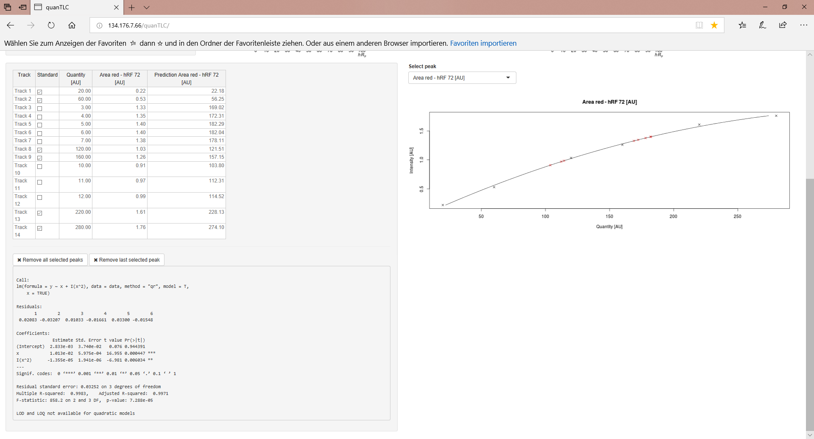
6
5
Scroll down and
5. Information on the model is printed.
6. It is possible to remove the selected or all calibration (to correct quantity information in the table for example). Finally, select the channel of optimal calibration.

Slide 12
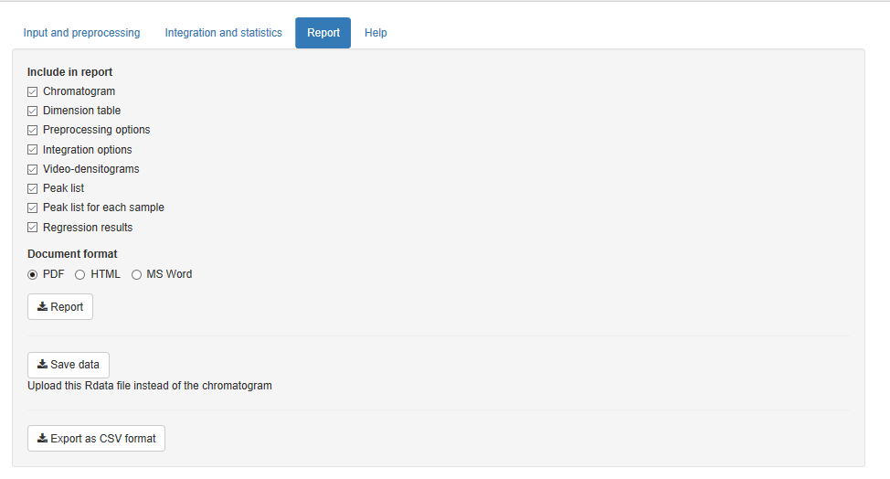
1
2
3
4
Data output
1. Select the “Report tab”
2. Check the information to be included in the report.
3. Select the format of report.
4. Click here to download the report

Slide 13
1
2
3
4
5
6
5. Save the data as *.Rdata file to be uploaded again. This is very useful for multiple HPTLC analyses using the same method, plate size and track pattern. After uploading the Rdata file (master) simply upload the plate image of the new analysis and everything is fine, immediately. Continue with densitogram extraction and calibration.
6. Export the results as *.csv file to evaluate them in another software or to make your own plot for publication in your software of choice.

